Slide 1
San Francisco Community Benefit Districts
Chris Corgas
Senior Program Manager
Christopher.Corgas@sfgov.org // 415-554-6661

Slide 2
What is a CBD/BID
What is a BID/CBD?
Private-Public Partnership
Formed by Property Owners
Provides Range of Services
Everyone Pays Assessments
Self-managed by Volunteer Board

Slide 3
CBD History
Created in 1969 in Toronto, Ontario, Canada
Came to the United States in 1974
Response to neglected urban centers due to surbanization
1989: California statute allows formation of CBDs
1994: California Property & Business Improvement District Law – combat short falls of 1989 law
2004: San Francisco passes Article 15
Leads to increase in amount of CBDs in the city
Cities with CBD/BID programs include: New York, Los Angeles, San Diego, Chicago, Seattle, Houston, Washington D.C, and Boston

Slide 4
Enabling Legislation
“1994 Act”
California Streets and Highways Code §§36600 et seq. – Property and Business Improvement District Law of 1994
“Article 15”
San Francisco Business and Tax Regulations Code, Article 15 - Business Improvement Districts Procedure Code

Slide 5
The 1994 Act
California Streets and Highways Code §§36600 et seq. – Property and Business Improvement District Law of 1994
Allows cities to fund business related improvements, maintenance, and activities through the levy of assessments upon the businesses or real property that benefit from those improvements
Sets forth processes on:
Establishing Districts
Calculating Assessments
Collecting Assessments
Governing Districts
Renewing Districts
Disestablishing Districts

Slide 6
Article 15
San Francisco Business and Tax Regulations Code, Article 15 - Business Improvement Districts Procedure Code
As a Charter City, the Board of Supervisors is able to augment and modify state legislation. In 2004, under the leadership of Mayor Gavin Newsom, created Article 15 which augmented and modified the CA Streets and Highways PBID Law of 1994 to allow the Board of Supervisors to do any of the following:
Reduce the percentage of petitions required from owners in order to initiate formation;
Have the district encompass residential property, and to assess residential property;
Extend the term of the district to a maximum of 15 years, or such longer term as is authorized by state law;
Extend the term of the district to a maximum of 40 years, if all or a portion of the assessments will be pledged or applied to pay any bond, financing lease (including certificates of participation therein), or other similar obligations of the City;
Recover through assessments the costs incurred in formation of the district;
Disestablish a district upon a supermajority vote of the Board of Supervisors; or,
Require a weighted two-thirds (2/3) vote of business owners to be assessed, based on ballots cast, as an alternative or additional procedure for establishing a business improvement district and levying assessments on business owners.

Slide 7
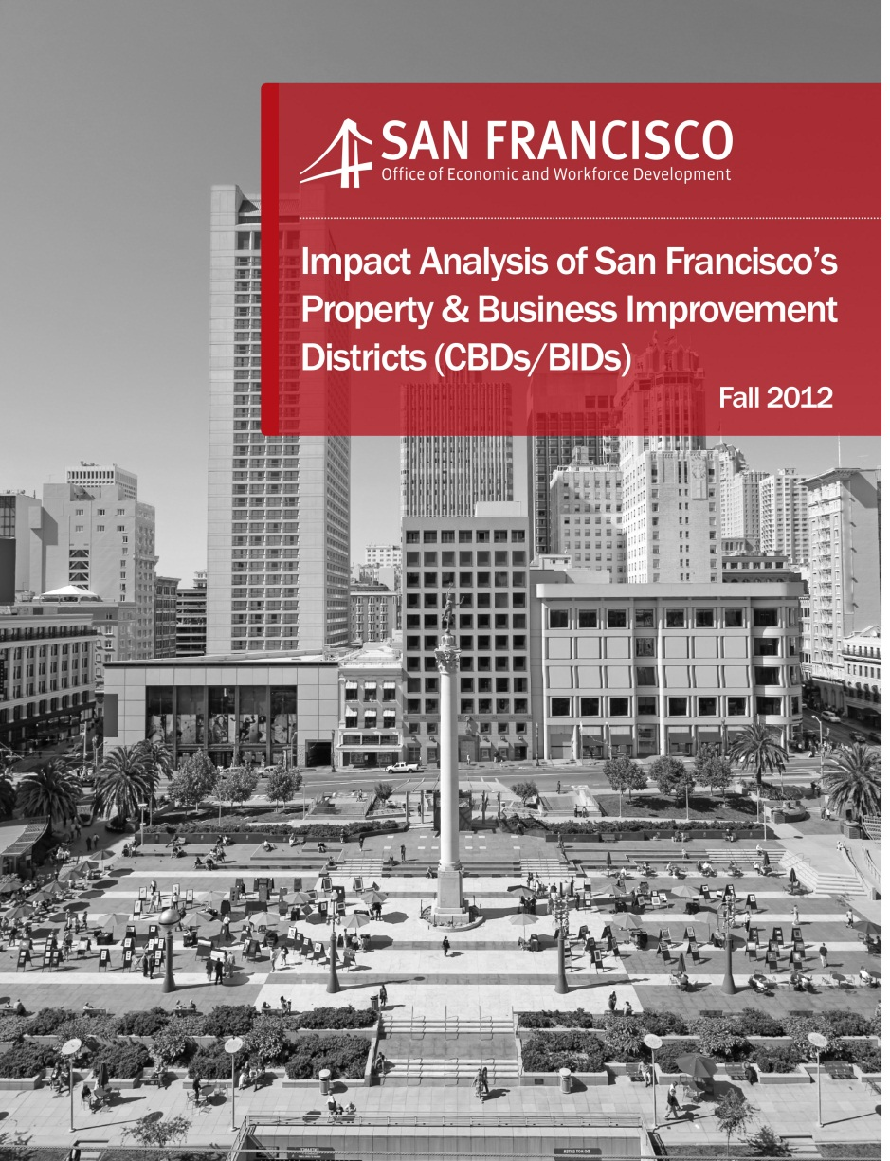
Are CBDs/PBIDs Effective

Slide 8
Analysis Findings
On average, CBD/BID-maintained streets were found to be cleaner than similar commercial streets located in the same Supervisorial District.
CBDs/BIDs have experienced declining crime prevalence similar to current citywide trends.
During the 07/09 recession, CBDs/BIDs retained more value in their properties, saw less significant reductions in sales tax revenues, and maintained lower commercial vacancy rates.
CBDs/BIDs have raised significant revenues from non-assessment sources.
CBDs/BIDs leverage significant community leadership to support their work.
The scale of CBD/BID operations is correlated with the level of improvement.

Slide 9
Current CBD Portfolio
There are currently thirteen (14) Community Benefit Districts. Twelve (12) are geographic based and two (2) are sector based.
Geographic Based Districts:
Greater Union Square
North of Market/Tenderloin
Noe Valley
Castro/Upper Market
Central Market
Yerba Buena
Fisherman’s Wharf (Landside and Portside)
Ocean Avenue
Civic Center
Top of Broadway
Lower Polk
Greater Rincon Hill
Sector Based Districts:
Tourism Improvement District
Moscone Expansion District

Slide 10
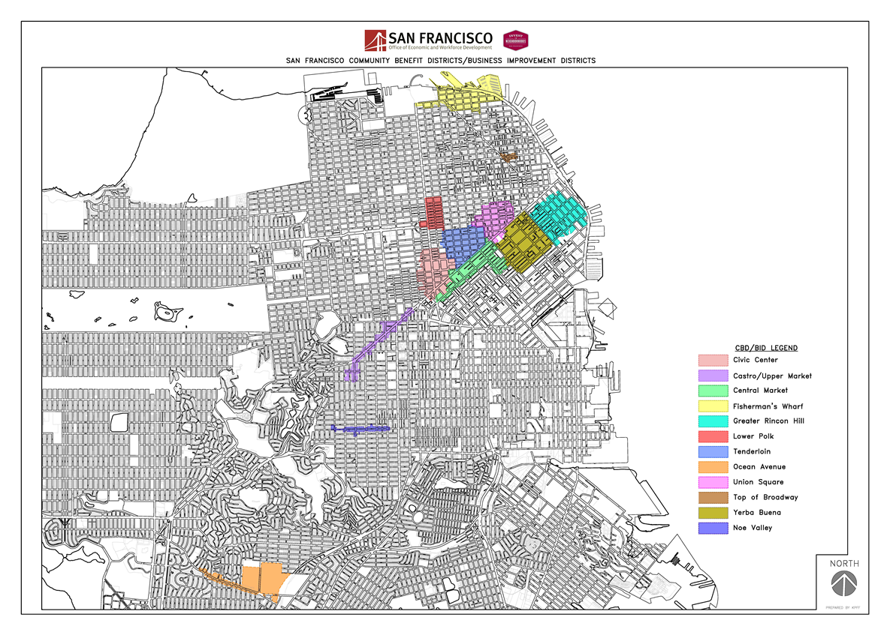
Current Citywide CBD Map

Slide 11
Formation Process
Formation Process
PHASE 1
PHASE 3
PHASE 2
Feasibility and Planning
Outreach
Legislative Authorization and Balloting
(3-4 months)
(12-18 months)
(4-12 months)
1-2 YEARS

Slide 12
Feasibility Phase
Instituted in 2015
Develop an operating framework for pursuing a CBD
Focused primarily on CBD education and community engagement
Gauges property owner support for a potential CBD
Property Owner Feasibility Survey
Approximately 25% response rate
Of responses, majority must be in favor of pursuing a CBD
Survey will also aid in drafting of potential Management Plan and Engineer’s Report

Slide 13
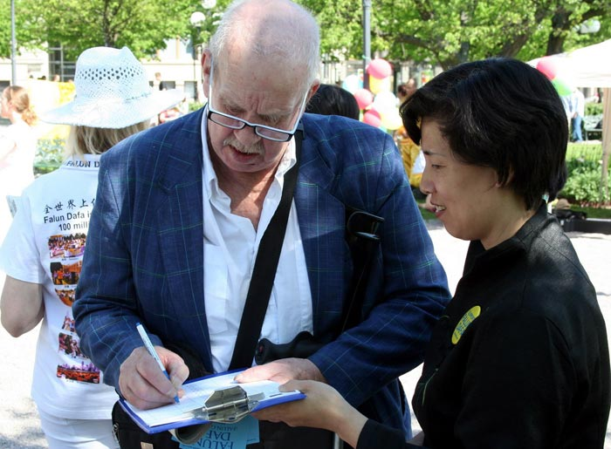
Key points to forming a district
Property Owner and/or Business Owners are the ones who sign petitions and ballots
Outreach to and involve ALL property owners in the proposed district from the onset

Slide 14
Key points to forming a district
Written petition of property owners who will pay more than 30% (50 in other CA Cities) of the proposed assessments is required to initiate balloting
Of ballots submitted, 50%+1 of the weighted assessments must be in favor of forming the district
Petition Phase
Ballot Phase

Slide 15
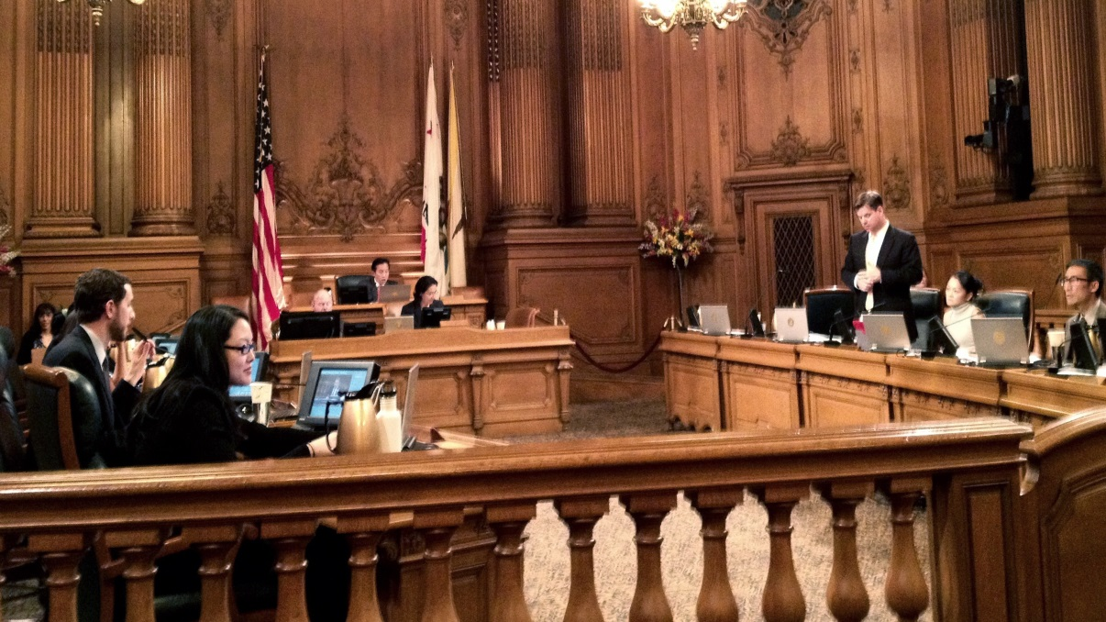
Key points to forming a district
The Board of Supervisors/City Council takes a final vote on whether or not to form a district (Resolution to Establish)

Slide 16
Other Impacting Legislation
Prop 218 and 26
California Constitution, Articles 13 A, C, & D
Prop 218 Omnibus Implementation Act
California Government Code, Sections 53750-53758
Brown Act
California Government Code, Sections 54950-54963

Slide 17
Summary
For more information please contact:
Chris Corgas
Senior Program Manager
415.554.6661
christopher.corgas@sfgov.org

