Slide 1
Department of Homelessness & Supportive Housing
March, 2017

Slide 2
Causes of Homelessness
Federal Policy
State Policy
HUD budget has been cut by nearly 80% (in real dollars) since 1978
Cost of the mortgage interest tax deduction is nearly $75 billion
Inconsistent funding for affordable housing
Costa Hawkins and Ellis Acts limit ability to regulate rental market
Prop 13 and other laws limit the ability to raise local revenue

Slide 3
Homelessness In San Francisco
\]
Adults
On any given night:
6,500 adults experience homelessness
3,500 people unsheltered
Over 14,000 people access services each year
Children
1 in 30 public school students are homeless
Families
On any given night 630 people in families experience homelessness
Youth
On any given night 853 youth experience homelessness on any given night

Slide 4
Homeless Services in SF
San Francisco has 1,400 shelter beds with over 1,000 people on the waitlist.
San Francisco has the highest number of supportive housing units per capita for homeless people in the USA (6,500) but only 800 units become available each year.
Rapid Re-Housing Subsidies

Slide 5
The Department of Homelessness & Supportive Housing (HSH)
Through the provision of coordinated, compassionate, and high-quality services the Department will work toward the goal of making homelessness in San Francisco rare, brief, and onetime.

Slide 6
Innovations in Ending Homelessness
Since the formation of the Department of Homelessness & Supportive Housing in summer 2016 progress has been made in key priority areas.
Encampment Resolution
Expanding Navigation Centers
Expanding Housing Options
Strategic Planning & Systems Change

Slide 7
Encampment Resolution Team
Prioritize the health and safety of people living in encampments and neighborhoods
Connect people with shelter and services
Multi-departmental collaboration
Re-encampment prevention team launched

Slide 8
Encampment Resolution Team

Slide 9
Navigation Center

Slide 10
Navigation Center
Notes:
Mission Navigation
1,084 individuals served
79% of all exits have been to stable destinations
The Civic Center Navigation Center:
171 individuals served
60% of exits have been to permanent housing in San Francisco.

Slide 11
Expanding Housing Opportunities
Permanent Supportive Housing (PSH)
Approximately 6,500 units for chronically homeless adults and families
PHS should be utilized for people with the longest histories of homelessness and most complex needs
New Housing
154 units for chronically homeless adults and veterans opened in Fall 2016
Coming Soon!
168 units for chronically homeless adults and veterans in Spring & Summer 2017
Notes:
New
The Crown – 50 units for chronically homeless adults and veterans
The Winton – 104 units for chronically homeless adults and veterans

Slide 12
Expanding Housing Opportunities
Moving On Initiative
350 Housing Choice Vouchers available for formerly homeless adults & families
Rapid Re-Housing
Short-term rental assistance for families
Connecting families with private market housing + support services
Notes:
Moving On Initiative
Through a partnership with the San Francisco Housing Authority, HSH is making approximately 350 Housing Choice Vouchers available for:
Formerly homeless adults graduating from supportive housing
Families exiting homelessness who need long-term affordable housing
Rapid Re-Housing
Short-term rental assistance for families
Connecting families with private market housing + support services
Over 90% of families remain housed after the subsidy expires
Heading Home Campaign
$30million public-private partnership to house 800 homeless families by 2019
Connect families with rapid re-housing
Reduce the length of time family spend homeless to 90 days

Slide 13
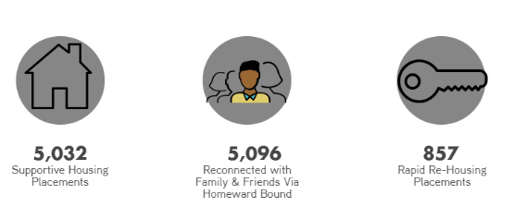
Successes: Housing Placements Since 2011

Slide 14
Strategy & Systems Change
Gaps analysis
Service system alignment
Strategic Framework
Outreach model
Data system develop-ment
HSH is developing a strategic framework to address homelessness by population
The strategic framework will be completed in Spring of 2017

Slide 15
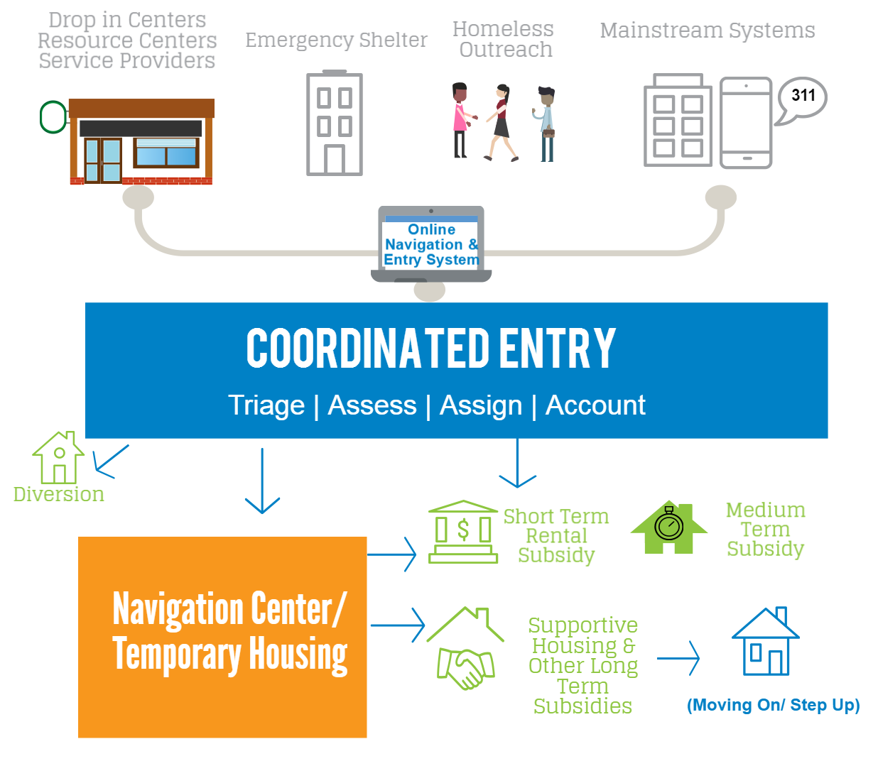
Coordinated Entry: A system-wide strategy for prioritizing people for housing and services based on need

Slide 16
Coordinated Entry
The ONE System (single data system) vendor has been selected
Coordinated Entry will be implemented by population
Veterans – Implemented
Families – Beginning in summer 2017
Adults –2017 - 2018
Transitional Age Youth – 2018
Notes:
Principles of Coordinated Entry:
Coordinated assessment tools for prioritization
Use of a system-wide database
Access in neighborhoods throughout SF
People are matched with the most appropriate housing and service resources
Increases transparency and fairness in the placement process
Providers can share data so clients do not need to be re-assessed at every program
A client-centric (rather than program-centric) system

Slide 17
HSH FY2017-19 Proposed Departmental Budget
Base Budget funding level
General Fund Support: 81%
Budgeted City Employees: 120
Work Orders = housing and medical services
Notes:
HSH proposed adjustments within its operating budget to address administrative needs and did not propose any reductions funding, including services to clients provided by non-profits.

Slide 18
FY2016-2017 HSH Budget

Slide 19
How Can You Help?
Radical Common Sense
Radical Generosity
Radical Compassion

